Slide 1
CE301 Individual Capstone Project Proposal
Chong Zhe Xhin
(CHONG06106)

Slide 2
Table of Contents
Background Reading
03 - 08
Technical Achievements
12 - 13
Project Objectives
09
Project Planning (Backlog)
14 - 19
Functional Requirements
10
Contact Details
20
Non-Functional Requirements
11
Reference List
21

Slide 3
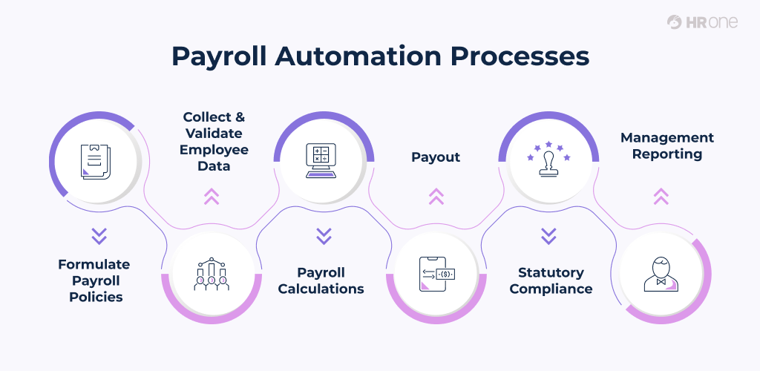
What is Automating payroll?
Payroll automation streamline all the processes linked to payroll management and processing as well as the processes around employee payments. This is achieved through payroll software which replaces manual payroll processes so that the latter can be run automatically—without the need of human intervention. [1].
Figure 1 [2]

Slide 4
Benefits of Payroll Automation
Increased productivity
High Accuracy
Allow for centralized control over the daily processes.
Data is updated across all components of the system simultaneously.
Cost-effectiveness
Automation processes
Lower cost than replacing all disjointed parts with a new single system.
Automating and simplifying data collection and processing.

Slide 5

Current Market Situation
Companies are trying to revive their businesses after pandemic.
Inventory stock level and sales revenue has boosted over the years, which leads to higher sales commission amount per employee.
HR will required to manually calculate the sales commission for monthly payroll while handling other tasks such as recruiting and training.
Calculation error will cause payroll to be delayed, while misunderstandings occur and penalty for late tax submissions.

Slide 6
By implementing payroll automation…
No more manual calculation for employee payroll monthly
Less time consuming
Less calculation error
Cost effective

Slide 7






Top Software Applications In The Market
Cin7
Odoo
Zoho Inventory
#1 Inventory Management System
Open source inventory management platform
Cloud based inventory management software
Akrivia Automation
JustLogin
QuickHR
Human Capital Management Software
1st AI Powered HRMS Software
Singapore HR Software

Slide 8
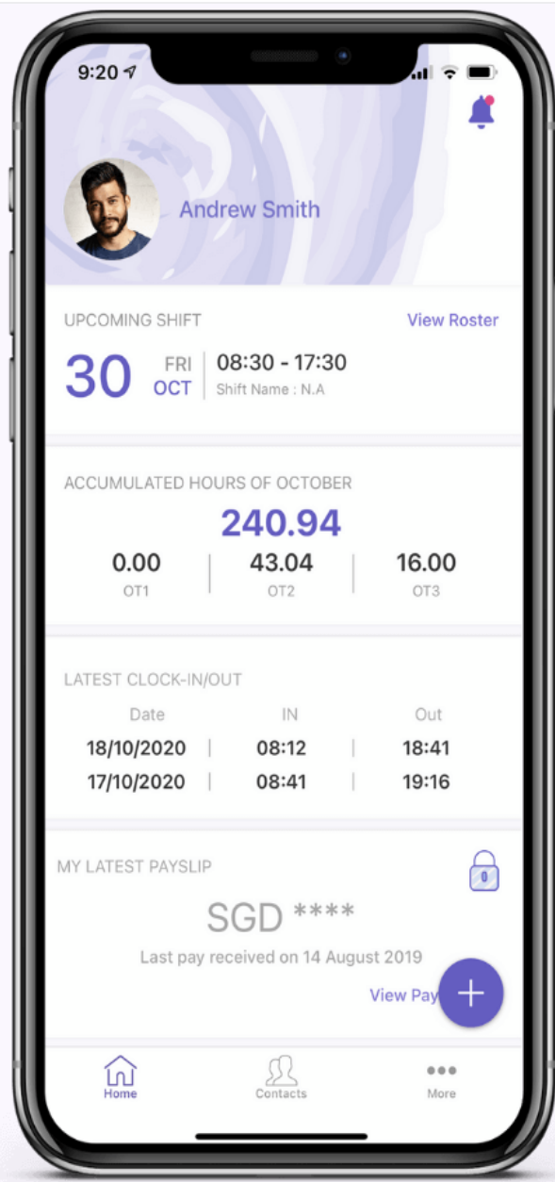
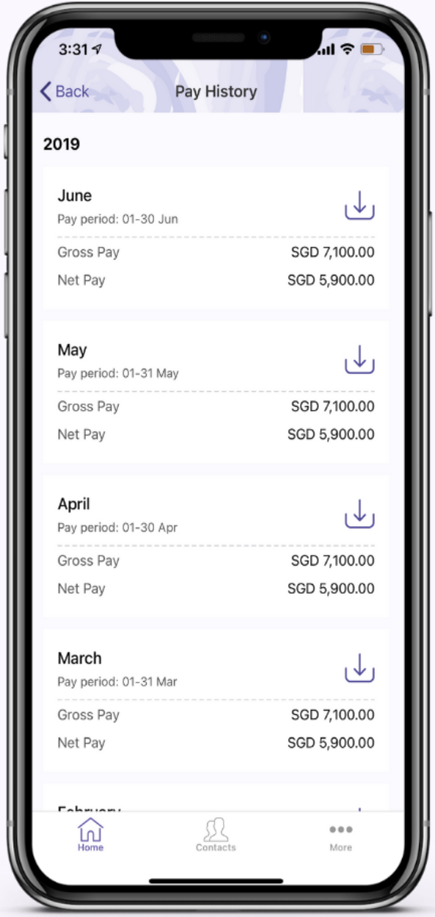
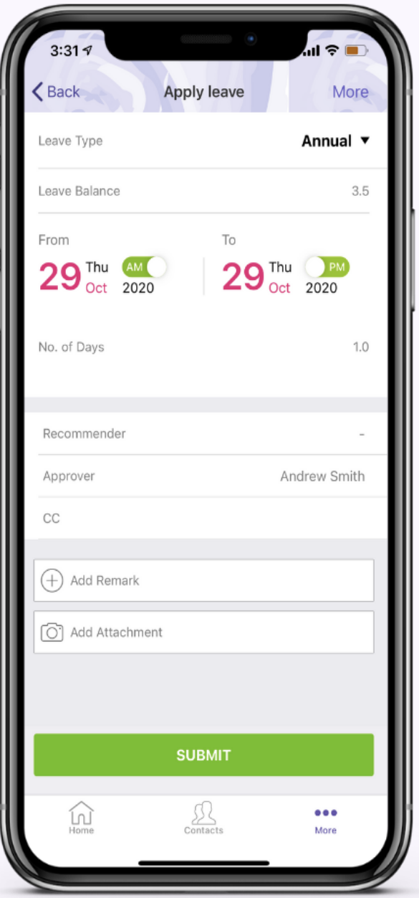
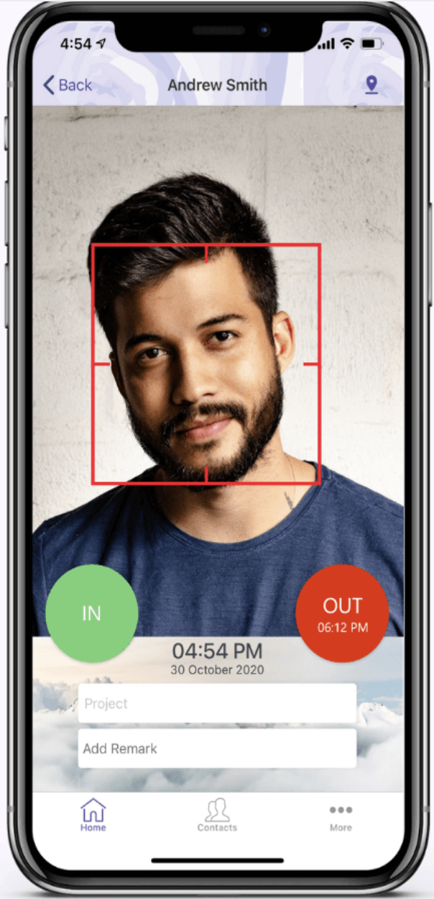
JustLogin Best Features
Customisable dashboard
[6]
Downloadable Payslips
[7]
Leave Application
[8]
Clock Attendance
[9]

Slide 9
Project Objectives
Efficient Inventory Management
Streamlines tracking, ordering, and reordering processes
Accurate Payroll Processing
Automates accurate salary calculations, tax deductions
Effective Leave Management
Simplifies employee leave requests, approvals, and tracking
Integration of Systems
Ensure accurate data flow and reduce manual data entry
User-Friendly Interface
Create an user-friendly interface for users to enhance usability

Slide 10



Functional Requirements
Inventory Management System
Employee Management System
Automating payroll
Product and Sales - Access product details and inventory locations
Check monthly product sales
Track sales performance
Generate sales reports
Security and Access
User Accounts
Leave Management
Payroll
Attendance Tracking
Bulk Updates
Custom Reports
Retrieve employee sales commissions from Inventory Management

Slide 11

Non-Functional Requirements
The system should be responsive and perform efficiently, even when handling large datasets.
Data security and privacy must be maintained, and the system should comply with relevant data protection regulations.
The system should have an intuitive and user-friendly interface for easy navigation by all users.
The system should calculate the payroll accurately.

Slide 12
Technical Achievements
Programming Language
Database
Project Management
Front/Back end – HTML, CSS, JavaScript
Programming Tool – Visual Studio Code (VS Code)
Database – MySQL
VS Code Extension - MySQL
Agile Method
Backlog Management – Jira
User Stories – Understand users requirements
Sprint Review – Conduct review in between sprints

Slide 13
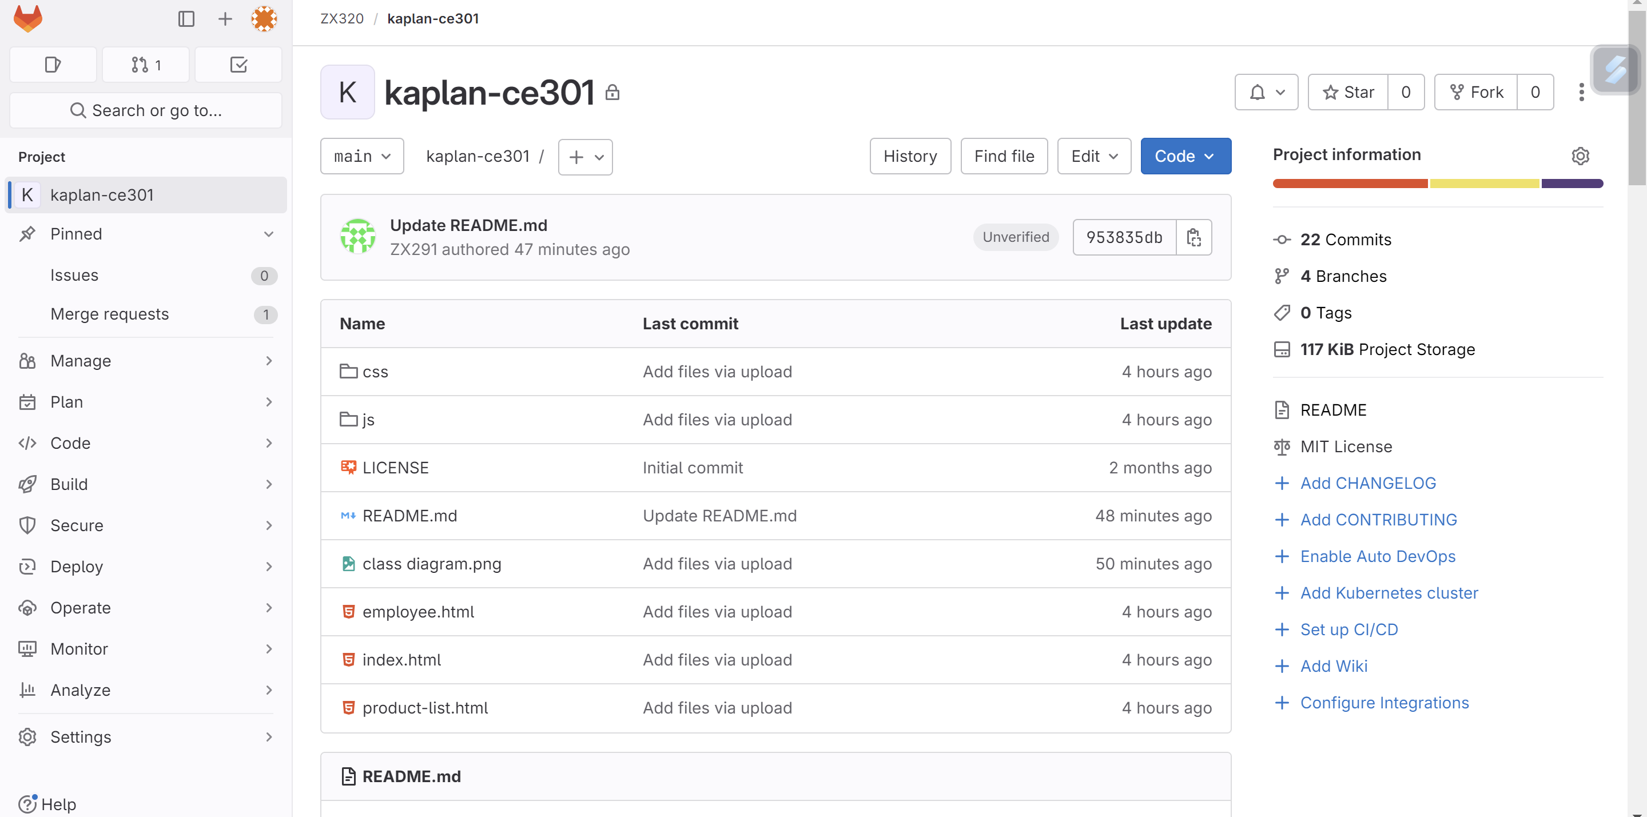
Technical Achievements
Gitlab: https://gitlab.com/ZX291/kaplan-ce301

Slide 14
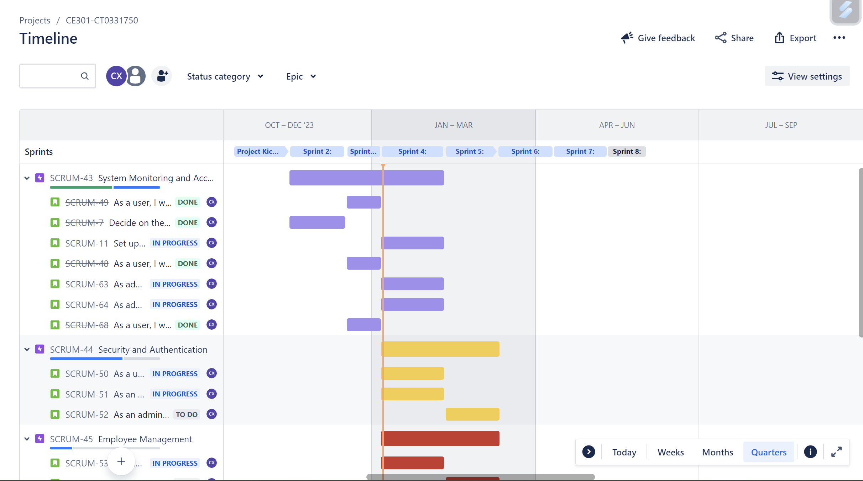
Project Planning
Jira Timeline - https://kaplan-ce301.atlassian.net/jira/software/projects/SCRUM/boards/1/timeline
Project is planned using backlog and timeline to create sprints and issues until 10th Jun 2024.
The issues will be shown in the Jira board in 3 categories: To Do, In progress, Done

Slide 15
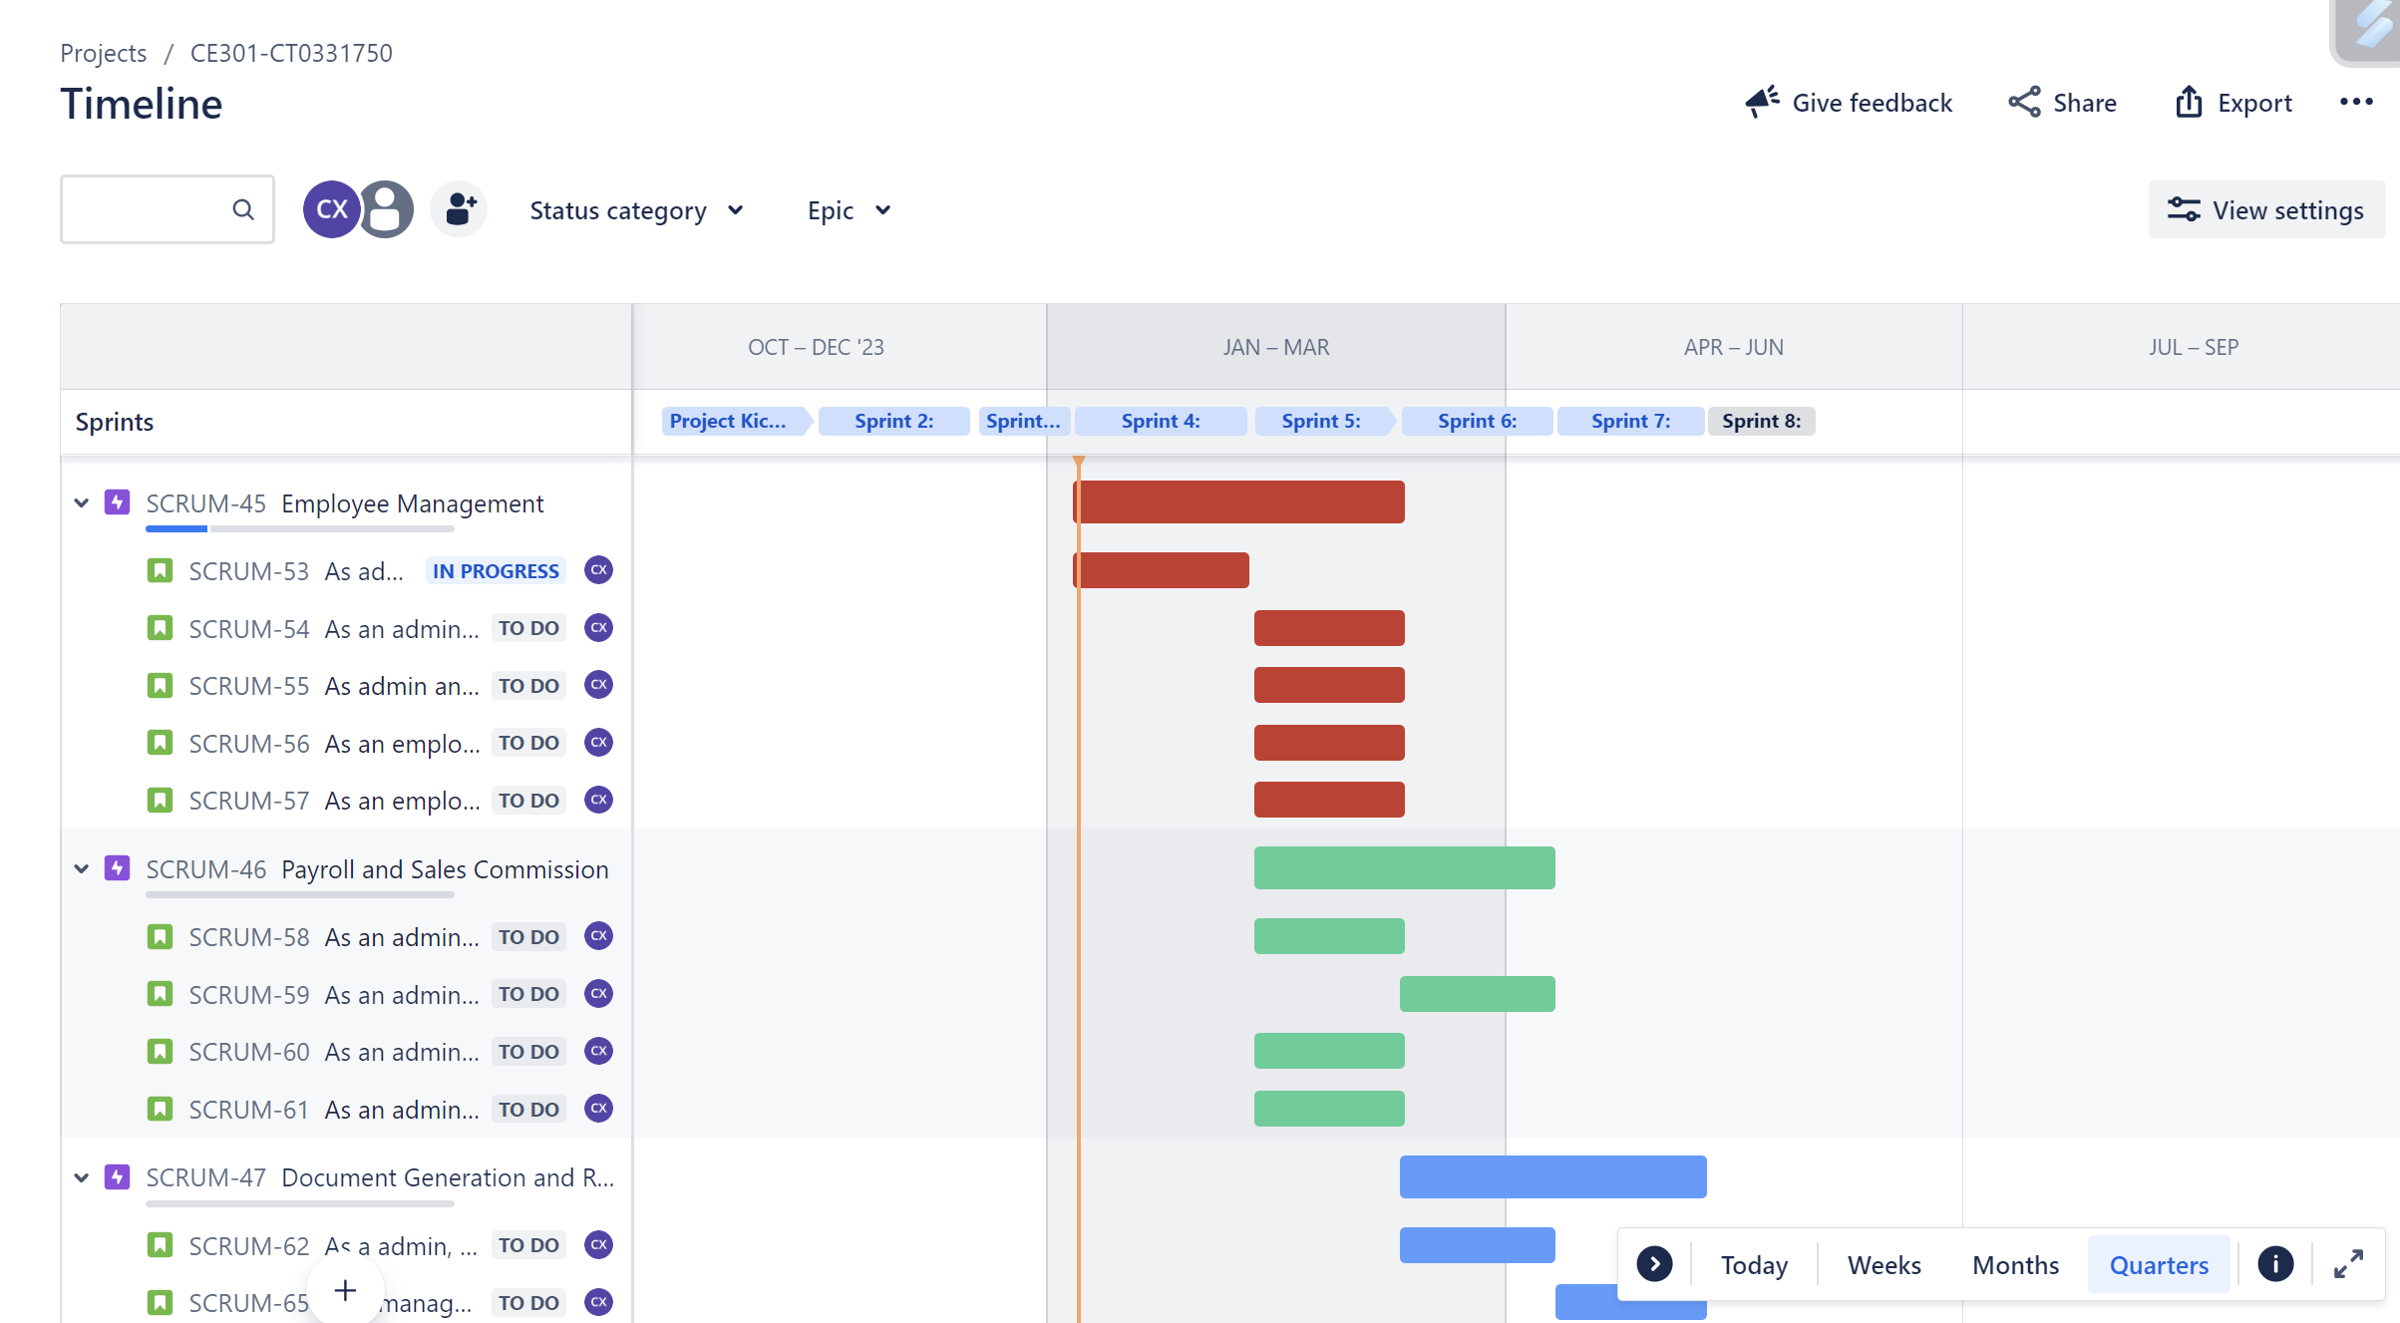
Project Planning
Jira Timeline - https://kaplan-ce301.atlassian.net/jira/software/projects/SCRUM/boards/1/timeline

Slide 16
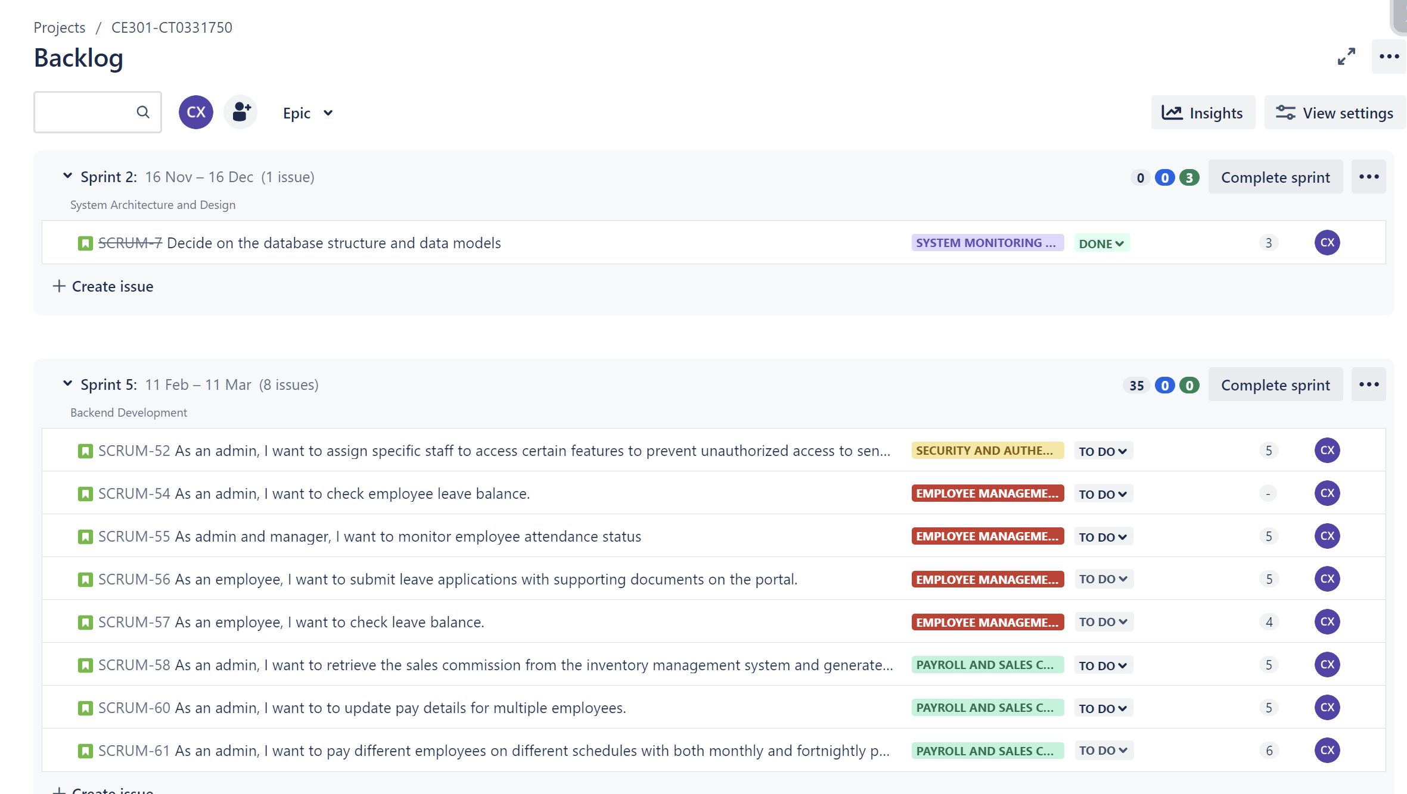
Project Planning
Jira Backlog - https://kaplan-ce301.atlassian.net/jira/software/projects/SCRUM/boards/1/backlog

Slide 17
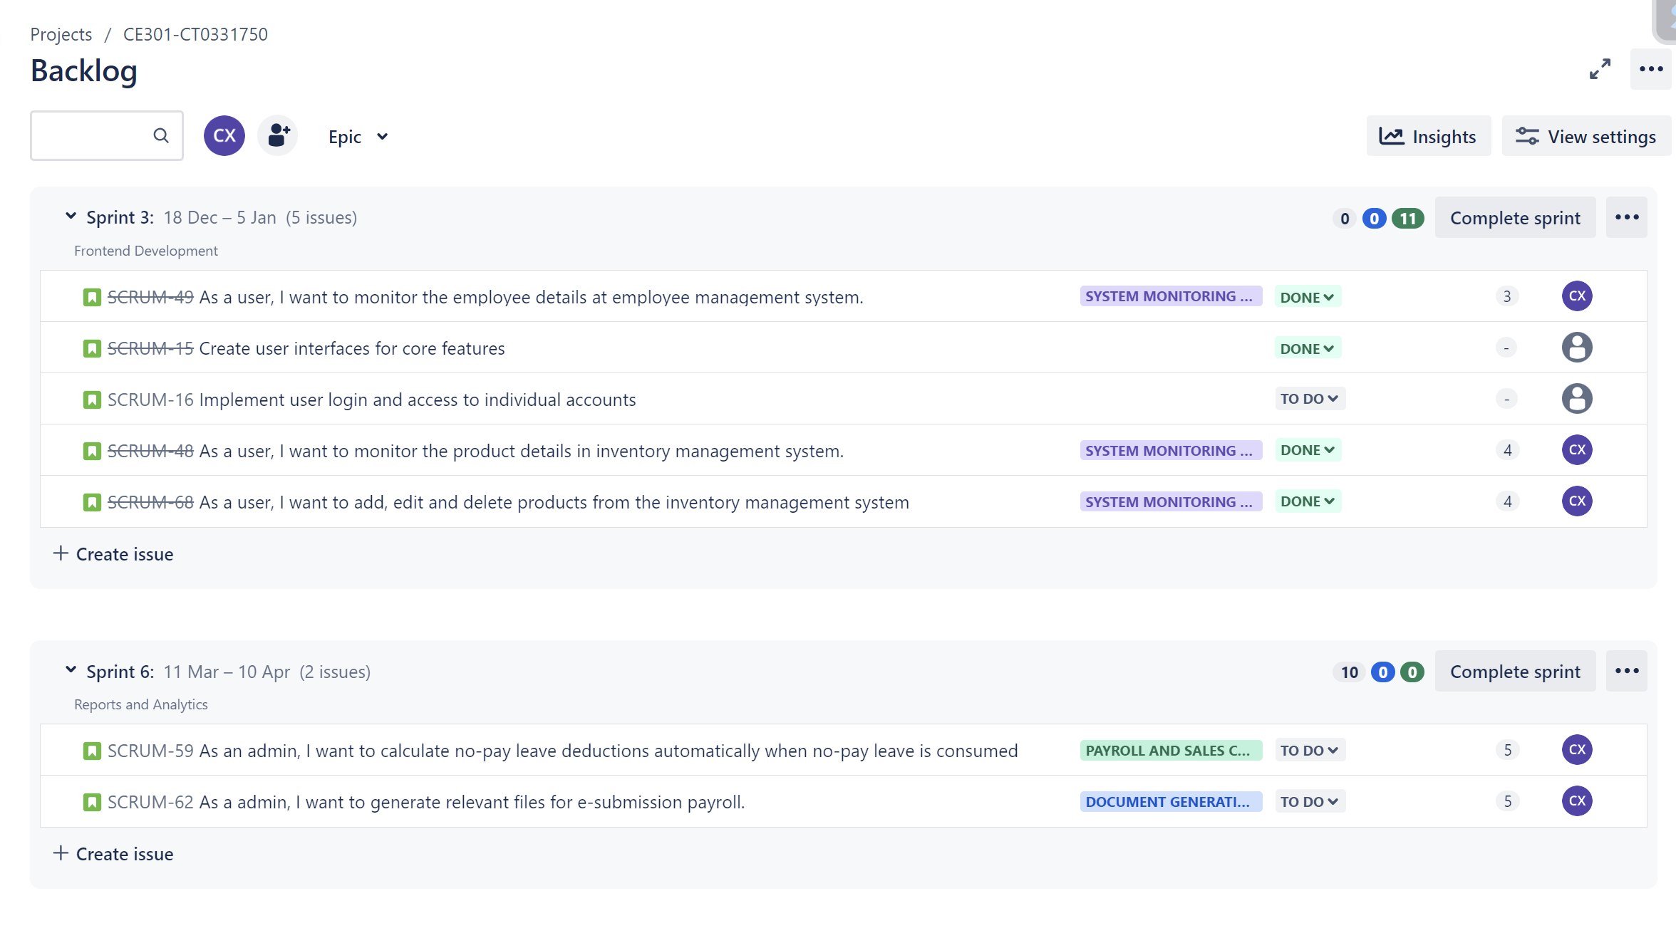
Project Planning
Jira Backlog - https://kaplan-ce301.atlassian.net/jira/software/projects/SCRUM/boards/1/backlog

Slide 18
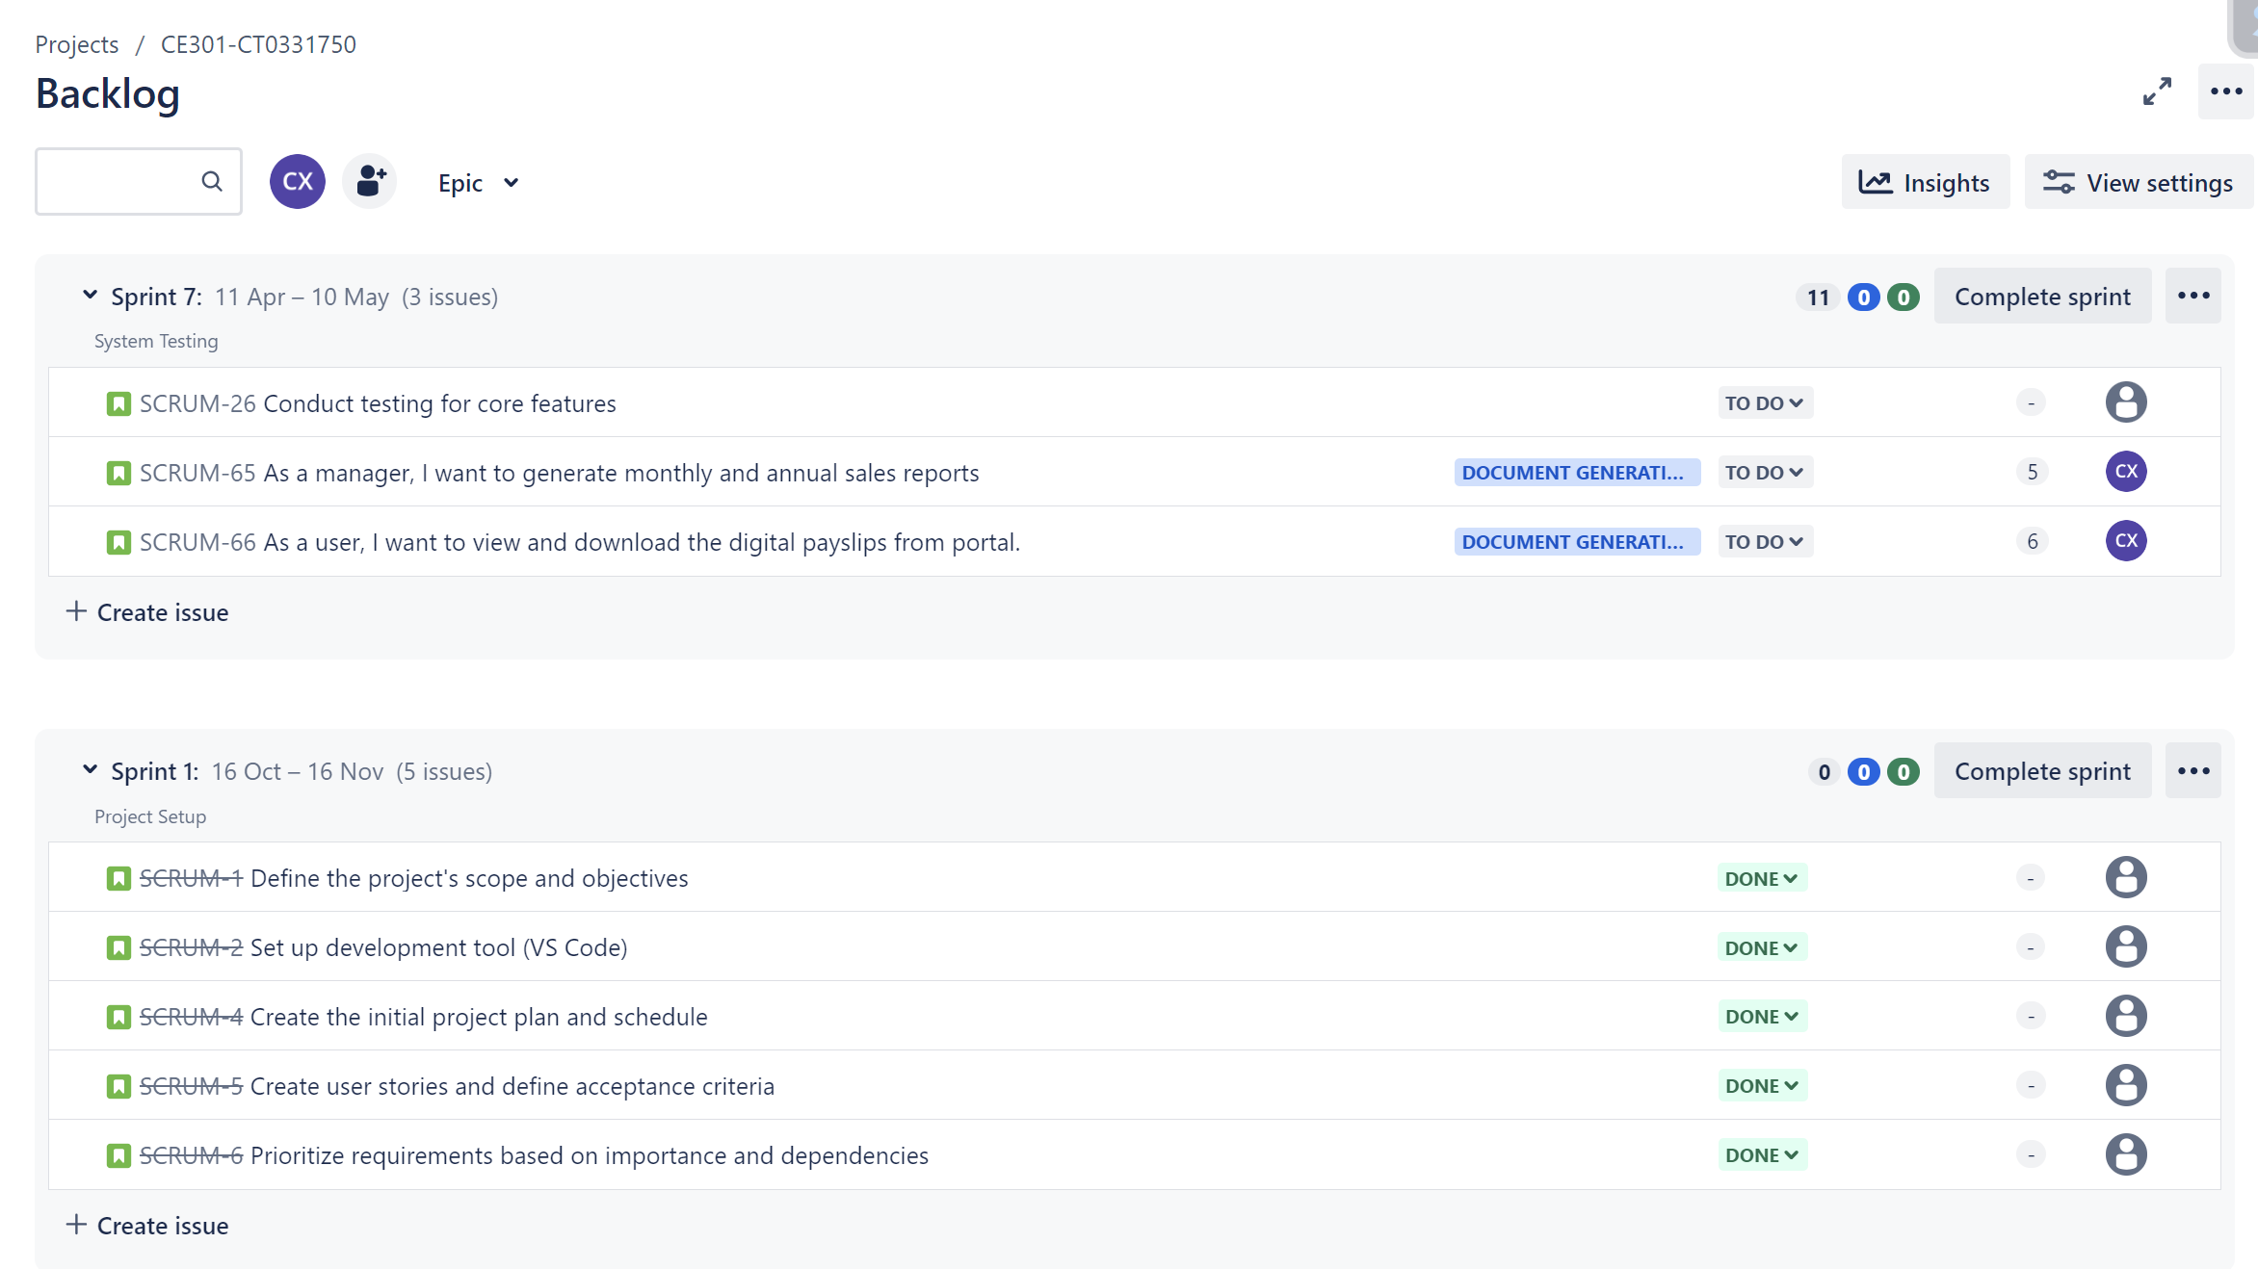
Project Planning
Jira Backlog - https://kaplan-ce301.atlassian.net/jira/software/projects/SCRUM/boards/1/backlog

Slide 19
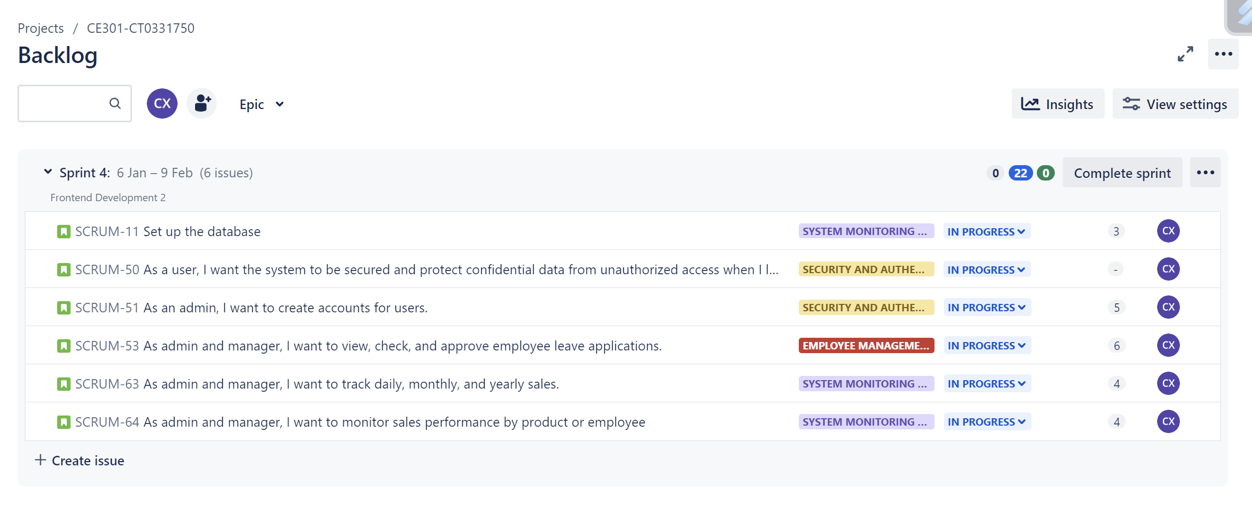
Project Planning
Jira Backlog - https://kaplan-ce301.atlassian.net/jira/software/projects/SCRUM/boards/1/backlog

Slide 20
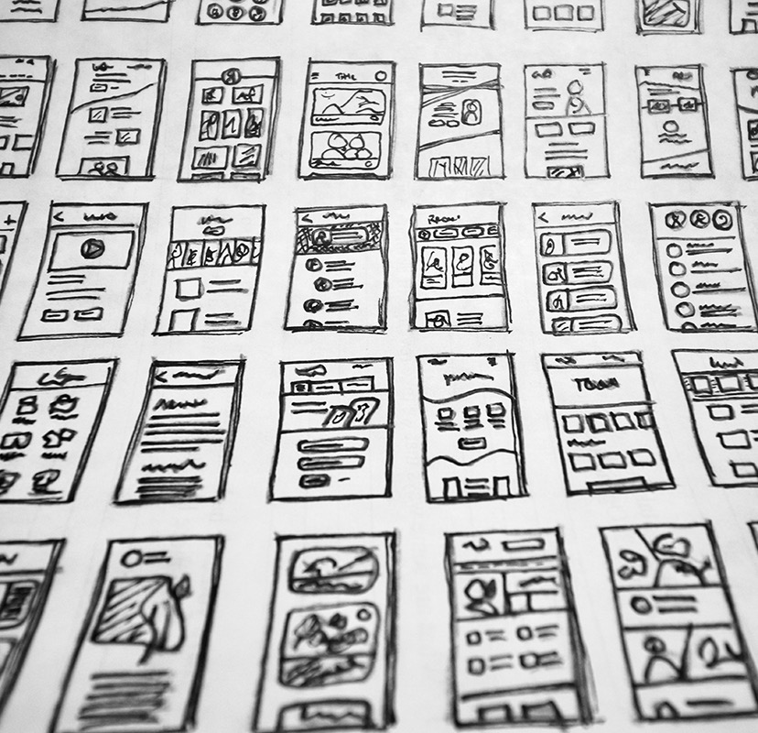
Contact Details
+65 9999 8888
ct0331750@kaplan.edu.sg

Slide 21
Reference List
[1] Lano, "What is payroll automation?," Lano, [Online]. Available: https://www.lano.io/academy/payroll/payroll-software/payroll-automation.
[2] T. Jain, "The Complete Guide To Payroll Automation: Benefits, Strategies, And Use Cases," [Online]. Available: https://hrone.cloud/payroll-automation-complete-guide/.
[3] CITY Clean and Simple, "HISTORY OF INVENTORY MANAGEMENT TECHNOLOGY," Metro Studios, 16th July 2018. [Online]. Available: https://www.citycleanandsimple.com/2018/07/16/history-of-inventory-management-technology/#:~:text=Oftentimes%2C%20inventory%20decisions%20were%20based%20on%20a%20hunch.&text=Long%20before%20the%20industrial%20age,%E2%80%9Ctally%20sticks%E2%80%9D%20to%20co.
[4] CITY Clean and Simple, "HISTORY OF INVENTORY MANAGEMENT TECHNOLOGY," 16th July 2018. [Online]. Available: https://www.citycleanandsimple.com/2018/07/16/history-of-inventory-management-technology/#:~:text=Oftentimes%2C%20inventory%20decisions%20were%20based%20on%20a%20hunch.&text=Long%20before%20the%20industrial%20age,%E2%80%9Ctally%20sticks%E2%80%9D%20to%20co.
[5] D. Jackson, "A History of the Payroll System," Staffology Limited, 22nd May 2022. [Online]. Available: https://www.staffology.co.uk/blog/history-of-the-payroll-system/#:~:text=7000%20BC%3A%20Earliest%20Recorded%20Payroll%20System&text=The%20earliest%20recorded%20payroll%20systems,used%20paper%20notes%20and%20coins..
[6] JustLogin, "Employee-First AI Powered HRMS Software," [Online]. Available: https://justlogin.com/wp-content/uploads/2021/03/9-e1604369155744.png.
[7] JustLogin, "Employee-First AI Powered HRMS Software," [Online]. Available: https://justlogin.com/wp-content/uploads/2020/11/11-e1604369244705.png.
[8] JustLogin, "Employee-First AI Powered HRMS Software," [Online]. Available: https://justlogin.com/wp-content/uploads/2020/11/8-e1604369059955.png.
[9] JustLogin, "Employee-First AI Powered HRMS Software," [Online]. Available: https://justlogin.com/wp-content/uploads/2021/03/New-Website-Graphics-4-e1605598124828.png.

Slide 22
Thank you for listening.

